Slide 1
Banking
on
Henrico
April 12th, 2022
Anthony J. Romanello
Richmond Mortgage Bankers
Notes:
Good morning. Thank you to Missy for the invitation to be here today.

Slide 2
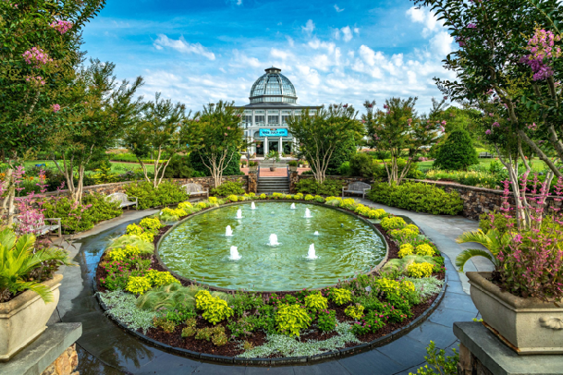
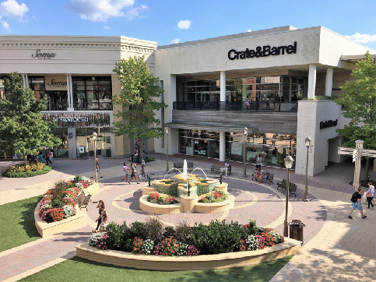
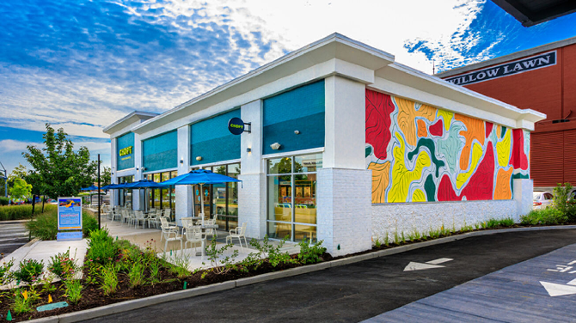
Henrico EDA: What We Do
Grow Henrico's economy for all
Do our part to help the County
My Job Description:
Salesperson
Cheerleader
Marriage Counselor
Convener
Possibility Awakener
Concierge
Teambuilder
Tapestry Weaver
Growing Henrico’s Economy For All
1
Notes:
At the EDA, we work with our businesses, county government, county manager, Board of Supervisors, and our EDA board to focus on two key things:
Growing Henrico’s economy for all, and
Helping our County government succeed.
Both our sons were married this year. There is no position more irrelevant that being father of the groom.
Sure, my wife has asked me about the menus for the rehearsal dinners, but after 28+ years of marriage, I know this is a courtesy only. And even if I balked at tilapia or beef tips, she could easily collect 59 senators to filibuster my objection.
The parents of the bride are front and center. The mother of the groom has a dance. I may get to offer a toast at the rehearsal dinner, but beyond that, I am told what to do and what to wear. I make many decisions every day, so being a bit player in the wedding story is more observation than complaint.
Like my groom-dad duties, the work we do in economic development is anything but command and control. We convene and cajole. We are marriage counselors, concierges, and cheerleaders. There is satisfaction in seeing things happen not because we willed them so, but because others believed in our vision and made the decision for themselves. When we awaken possibility, our communities grow stronger.
Maybe command and control are overrated. And don’t worry about this groom-dad, I have three daughters.

Slide 3
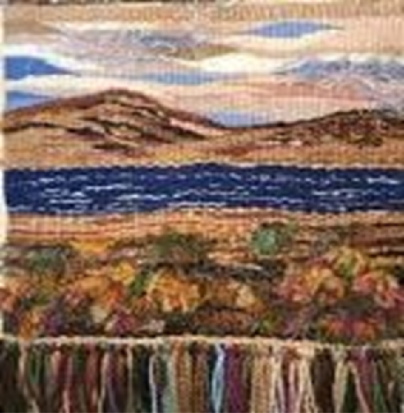
Recent Wins:
Growing Henrico’s Economy For All
2
Notes:
We’re proud to say Henrico’s economy has grown even stronger during the pandemic. Here’s our new corporate partners as well as those who announced expansions since March of 2020.
Recently, we went over three months between announcements. A friend and asked, “Anthony, it’s been three months since your last announcement – what are you guys doing!?”
I told him that we were getting our hair and nails done.
We all love announcements - jobs, capital investment, media, and community excitement about a growing economy. But announcements are like the Thanksgiving dinner that takes two days to prepare and is eaten in ten minutes. Some economic development wins take months and years to bring to fruition.
Think of a tapestry. On the front is a beautiful scene, with every thread in place to show the artist’s vision. Turn it over. On the backside, you’ll see a mess of threads going in all directions that reveals the complexity, chaos, uncertainty, and effort of every economic development project.
No, we are not getting our hair and nails done while we wait for the next announcement (it seems too late to wash out my grey anyway). We are helping to build a great Henrico - one meeting, one handshake, one relationship at a time. Seeds are sown every day, and the fruit comes in its own time.
After all, announcements are not about us. They’re about the families whose lives are changed through good jobs and a great community.

Slide 4
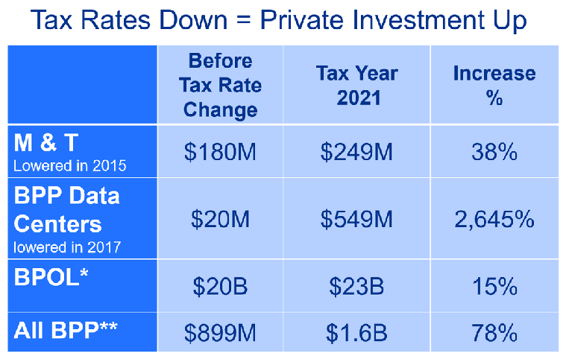
How We Measure Success Part I
Data Center Tax Revenue Up 300% in 4 Years
FY 22 Wins
Gross County Product:
$25.4 Billion,#4 in Virginia
885k Sq. Feet
1,072 New Jobs
$70M in Wages
$254M Investment
Growing Henrico’s Economy For All
3
Notes:
How do we measure success?
First, I’ll discuss our traditional metrics – jobs, investment, payroll.
Since the beginning of FY 22 in July, Team Henrico has landed 8 wins totaling:
$254M in investment
885K SF
1,072 new jobs
Our GCP is fourth highest in VA at $25.4B.
Our Board of Supervisors has taken aggressive steps to reduce the tax burden on businesses and as the chart shows, that effort is paying dividends as private investment has increased dramatically.
In 2017, the data center tax rate was reduced by 90% and revenues are up 300% over four years.

Slide 5
How We Measure Success Part II
Growing Henrico’s Economy For All
4
Notes:
But it’s not enough to focus on county-wide metrics or traditional jobs and investment metrics. Using the Brookings Metro Monitor we’re taking a deep dive into metrics across our county focused on growth, prosperity, inclusion and racial inclusion. This will become the data behind our mission to grow Henrico’s economy for all.
For example, while Henrico’s per capita income is $97K, our median family income is $70K. We make sure we keep in mind that half our families live on less than $70K annually.

Slide 6
ESG &
Equity and Inclusion
Proactively engage with new and existing companies doing business in Henrico to discuss supply chain, vendor, and contractor needs
Host webinars with the Purchasing Division of Henrico County to educate Henrico businesses on the small, women – and minority – owned (SWaM) certification process
Equip businesses with the resources and networks needed to drive shared success
Support businesses in executing their environmental, social, and governance (ESG) standards
Assist in demonstrating industry leadership while driving profitability and making the world a better place
Growing Henrico’s Economy For All
5
Notes:
We work hard to help our businesses meet their ESG goals. ESG isn’t only the right thing to do, it’s good business.
In the last year plus, our efforts with SWAM businesses have become particularly intentional as we work with prospects to educate them on the SWAM ecosystem at the front end of their projects.
The SWaM webinar series is a partnership between Henrico County, the VA Small Business Development Center (SBDC).
SWaM 1.0, March 15th – 80 attendees
provided an overview on the importance of the SWaM certification in accessing state, local, and private contracts and solicitations for services
SWaM 2.0, March 29th – 47 attendees
Live demo of the SWaM certification application process

Slide 7
Henrico Investment Program
Incentives include:
Architectural design assistance
Building facade and structural grants
Paving and parking lot sealing grants
Landscaping grants
Off-site improvement grants
Building demolition grants
Plan review/permit fee waivers
County sewer credits
Existing signage grants
Designed to provide incentives to property owners and businesses within and outside of the current Enterprise Zone to promote redevelopment
Expands existing Enterprise Zone incentives to the new HIP zones
Applicable to commercial and industrial uses
Centered around 5 corridors:
Mechanicsville Turnpike
Staples Mill Road
West Broad Street
Patterson Avenue
Williamsburg Road
Growing Henrico’s Economy For All
6
Notes:
The BOS recently approved Henrico Improvement Zones (known as HIP). In a previous slide, I showed you various companies we’ve helped in the last several months. While you saw global Fortune 500 companies on that list, we work with all businesses. The HIP program will help revitalize aging corridors to help all businesses –regardless of their size - succeed and grow.

Slide 8
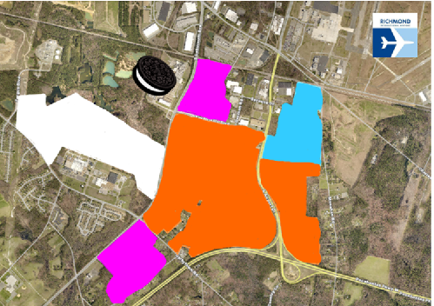
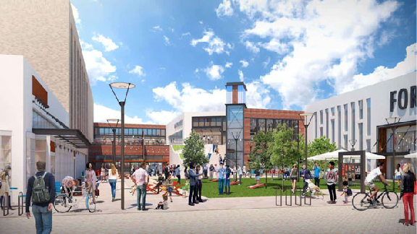
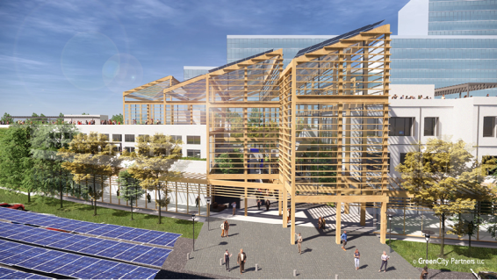
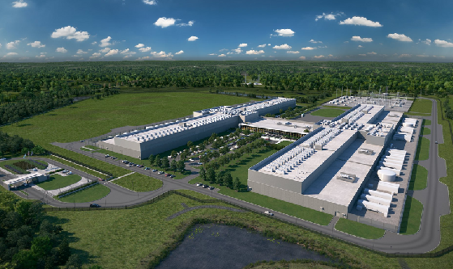
Henrico’s Future
Growing Henrico’s Economy For All
7
Notes:
Going clockwise, starting with Laburnum Avenue Corridor in the top left.
Laburnum Avenue Corridor
1.6 MSF built since 2017
700+ acres of entitled industrial property
6+ MSF of additional industrial space potential
Regency:
50-acre property rezoned to urban mixed-use
Residential, office, cultural
NOVA Aquatics Center
$500 in private investment
Virginia Center Commons
Indoor sports and convocation center
Public-Private partnership
Urban-style mixed use
$50 investment by Henrico County
$250M private investment
GreenCity:
$2.3B arena-anchored development
Private Financing – no impact on taxpayers
Former Best Products site & assemblage of 204ac
Mixed use eco-district including:
17,000 seat arena
2.3MSF office & retail
2,400 housing units
2 hotels
Operational 2025 and full build out 2033
White Oak Technology Park
2,400 acres (about ½ Ashland’s size)
Home to Facebook, LL Flooring, Bank of America, Polykon, & QTS (4th largest data center in world).
90% of the world’s data created in the last 2 years
99.7% of that data moves through undersea cables, AND
4 of those cables converge at the QTS Network Access Point (NAP).
While 70-80% of the world’s data moves through Ashburn VA, Henrico is the center for diverse and resilient traffic to Europe, South America, and soon Africa.
Henrico’s internet infrastructure will be transformational to Virginia’s economy. It is to the 21st century what I-64 and I-95 were to the 20th.
Please watch this video.

Slide 9
8

Slide 10
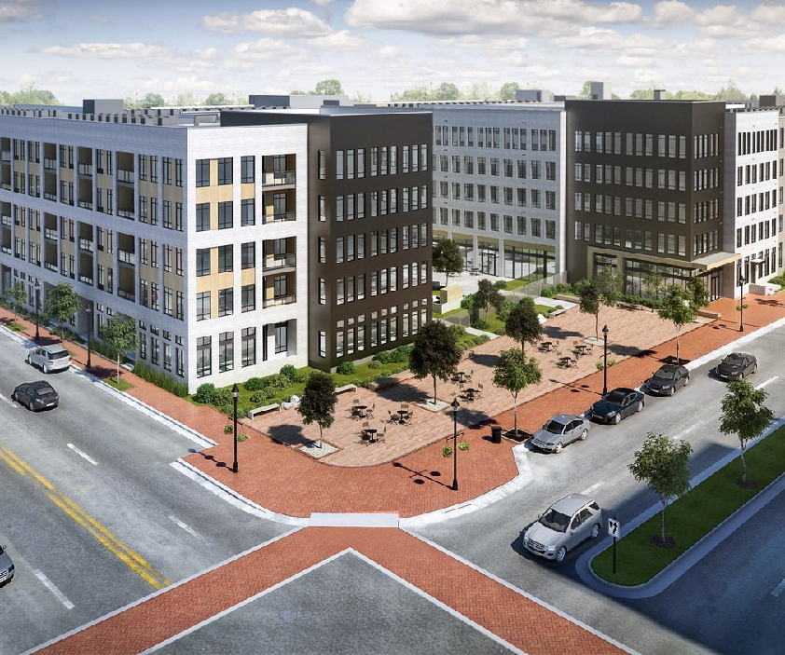
Big Questions: A New Tomorrow
The Coronavirus is a public health hurricane that caused an economic tornado. As this tempest of wicked winds calms, our world is forever changed. If recovery is defined as the act of returning to normal, waiting for recovery is folly. This is A NEW TOMORROW. Some big questions we are asking:
What is the future of people space?
What will we do in the future that we didn’t do before the pandemic?
What is the future of brick-and-mortar retail?
How do we connect with everyone?
Can America become a manufacturing center again, particularly for pharmaceuticals, semiconductors, and medical supplies and PPE?
Growing Henrico’s Economy For All
9
Notes:
As we celebrate the promise of our digital infrastructure, we’re asking some big questions …
Henrico has 22MSF of office (34% of RVA total)
Office space – tough in the near term but LT opportunity since we will have product and our QOL factors are top-rated
We need to tell our story. We don’t want to be anyone’s best kept secret rule)
Henrico has 27MSF of retail/restaurants (33% of RVA total)
Retail – opportunity for redevelopment (T-Mobile, VCC, Regency)
Manufacturing
Never miss the opportunity in a crisis (pandemic lessons)
How do we connect with everyone?

Slide 11
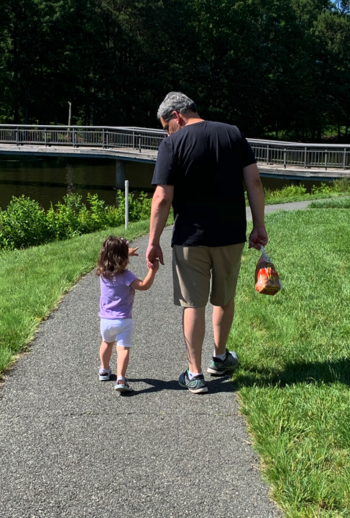
Random Thoughts from a Middle-Aged Guy
Listen with both ears and both eyes.
Curiosity is a virtue - ask lots of good questions.
A.I. is no substitute for R. E. (real empathy)
Ask daily - who is my neighbor and how can I serve?
Not all jams are bad.
Re-discover the familiar – again and again.
Growing Henrico’s Economy For All
10
Notes:
I have come to understand that leadership is not a place or position or title. It is a behavior. I thought I would share a few parting thoughts on exercising leadership, at least from my first 51 years.
Listen with both ears and both eyes. Put down the iPhone!
Curiosity is a virtue. Remember who wins on Jeopardy – it’s not those who know the answers, but those who ask the right questions.
A.I. is no substitute for real empathy (RE). While we celebrate the remarkable productivity enhancements and economic gains that AI offers, only people can create, discern, and love.
Ask daily who is my neighbor. A police chief once told me that half the calls his department received people needed a police officer. The other half they needed a neighbor.
Not all jams are bad.
In September my wife Diane had left early Tuesday with our daughter Anna for the University of Oregon where Anna was starting her Freshman year. I decided I would try what most American families had done all through the pandemic. I was going to work from home with my three-year-old.
It was just the two of us for five days. My attempt to be a WFH dad resulted in a sub-par executive director and an even less effective dad. Sitting next to me during several meetings one morning, Shelylyn reached her limit of Fancy Nancy and Rainbow Rangers and put down the iPad saying, “That’s enough TV.” I never thought I would hear those words.
When Saturday came (day 5) I knew it would bring a request from Shelylyn for our usual Saturday lunch - a peanut butter and jelly sandwich, so we went to Costco for a giant pack of Welch’s.
We searched every aisle, but Costco had no jelly.
How could I let her down with something as simple as a PB&J? Then I remembered one of my favorite definitions of leadership: leadership is disappointing your people at a rate they can handle*.
We drove home from Costco and unloaded our jelly-less purchases. We had strawberry jam in the refrigerator. I checked the date – sometime in 2022 – thank goodness. I offered her a sandwich with just peanut butter or one with peanut butter and strawberry jam. She chose the latter. I spread the jam carefully so that only the strawberry broth lined the bread and returned the strawberry pieces to the jar. I was fairly certain that Shelylyn would object to a chunky PB&P.
After one bite of her peanut butter & jam sandwich, Shelylyn said, “I don’t like this.” I offered to make her a peanut butter sandwich or to warm up a hot dog leftover from last night’s dinner. She said, “no thank you” and went back to her grapes and carrots. I had cut it into quarters, and after a few minutes, she separated it further into eight pieces eating each side of the sandwich just like an Oreo.
When the whole sandwich was gone, I asked if she liked it and she responded with a resounding, “Yes.” I was relieved – at least one of dad’s improvisations this week had gone well. Later that day we found Welch’s grape jelly at Publix.
I suppose running out of jelly isn’t so bad. Sometimes it’s good to be in a jam.
Rediscover the Familiar – Again and Again
I will leave you with this thought – and that is to rediscover the familiar. If you find yourself not taking joy in the beauty and simplicity of the world around us – find a four-year-old. Every rock is a gem, every dandelion is a rare orchid, every crayon creation is a DaVinci. For my little girl, everything is new and amazing.
May we all be amazed by the simple beauty around us.
*Marty Linsky, John F. Kennedy School of Government. Harvard University.

Slide 12
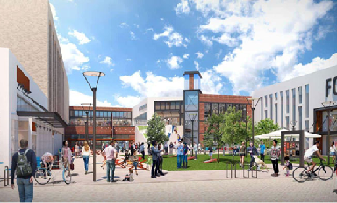
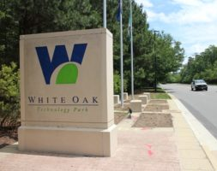
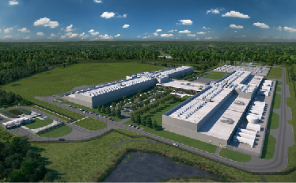
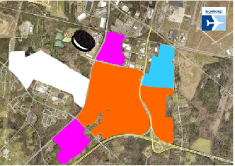
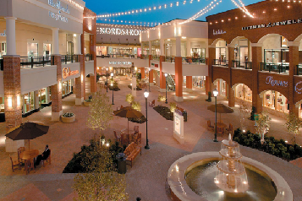
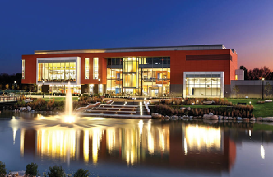
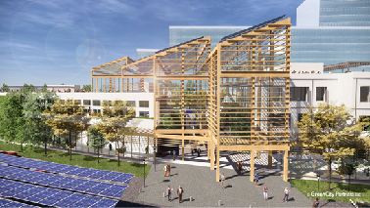
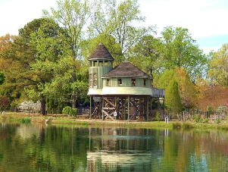
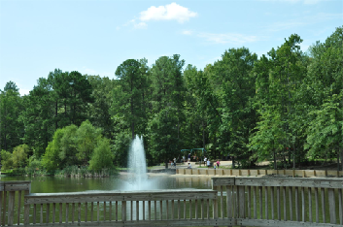
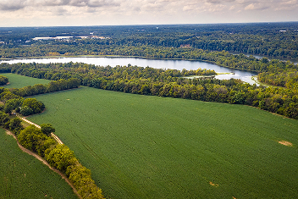
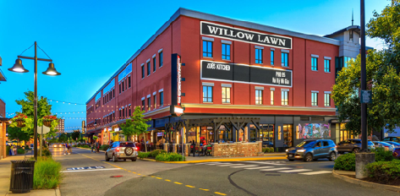
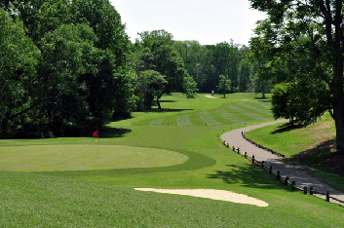
Anthony J. Romanello
804-501-7521
anthony@henrico.com
11

